Slide 1
New Development in Ontario’s Greenbelt
Group 12: Arc-Arc! Bark-Bark! Grrr-Meow
Artem Oleinikov (1006124230) Bhagatinder Longia (1007291770)
Musab Muhammad (1006472559) Sunny Parmar (1006208587)
Young Jun Jeong (1006046468) Yousuf Mirza (1004278863)
Notes:
(All): Hello everyone, our group is-
(Yousef & Musab): Arc! Arc!🐕
(Sunny & Bhagat): Bark! Bark!🐕
(Young Jun & Artem): Grrr…🐕 Meow!🐱

Slide 2
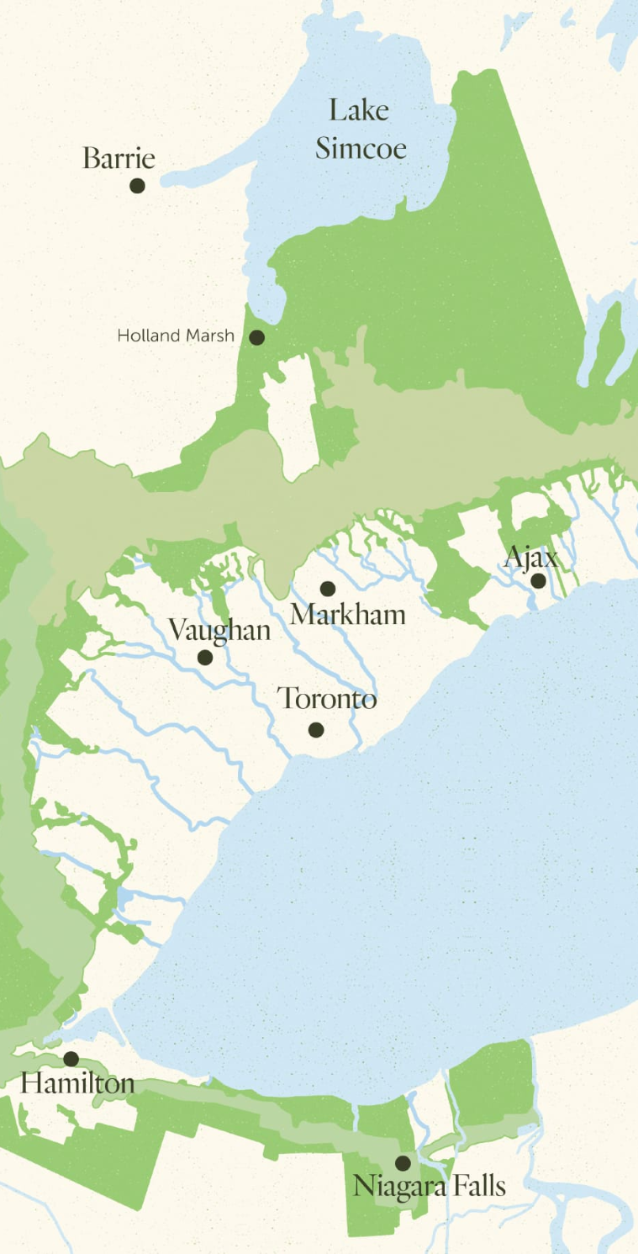
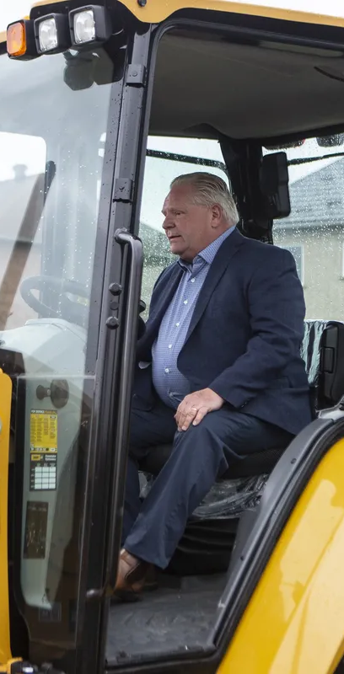
Disclaimer
We do not condone removing or transfering area from Ontario’s Greenbelt for sprawl style development – only used as an idea for this assignment.
Notes:
Artem: As a disclaimer, we as a group do not support the actions of the government of Ontario to remove or transfer land from the existing greenbelt. Ever since we’ve chosen this topic, the issue has progressed a lot with numerous protests happening all over the greater toronto area. We just thought it would be fitting for this assignment and to analyse how viable this idea is through the tools that arcGIS provides.

Slide 3
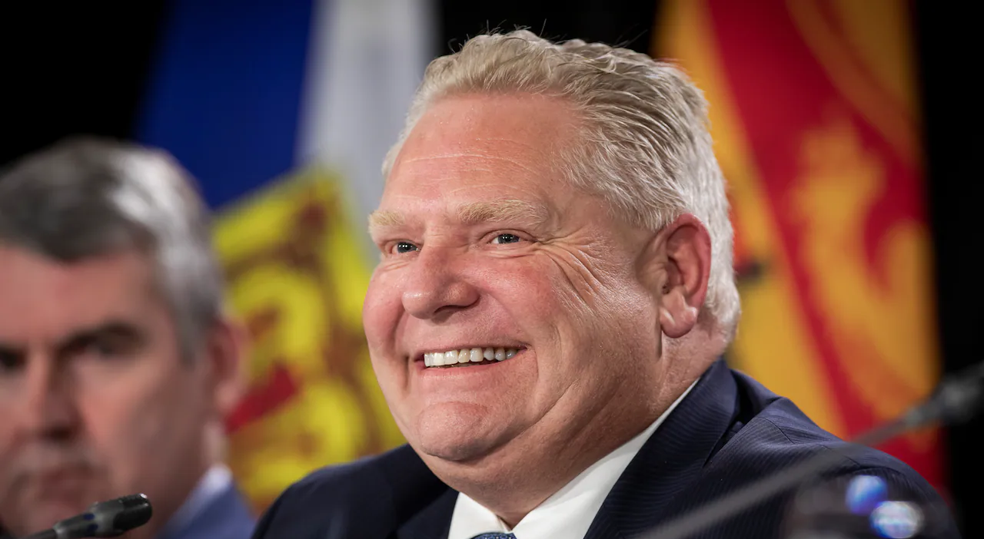

Notes:
Musab:

Slide 4
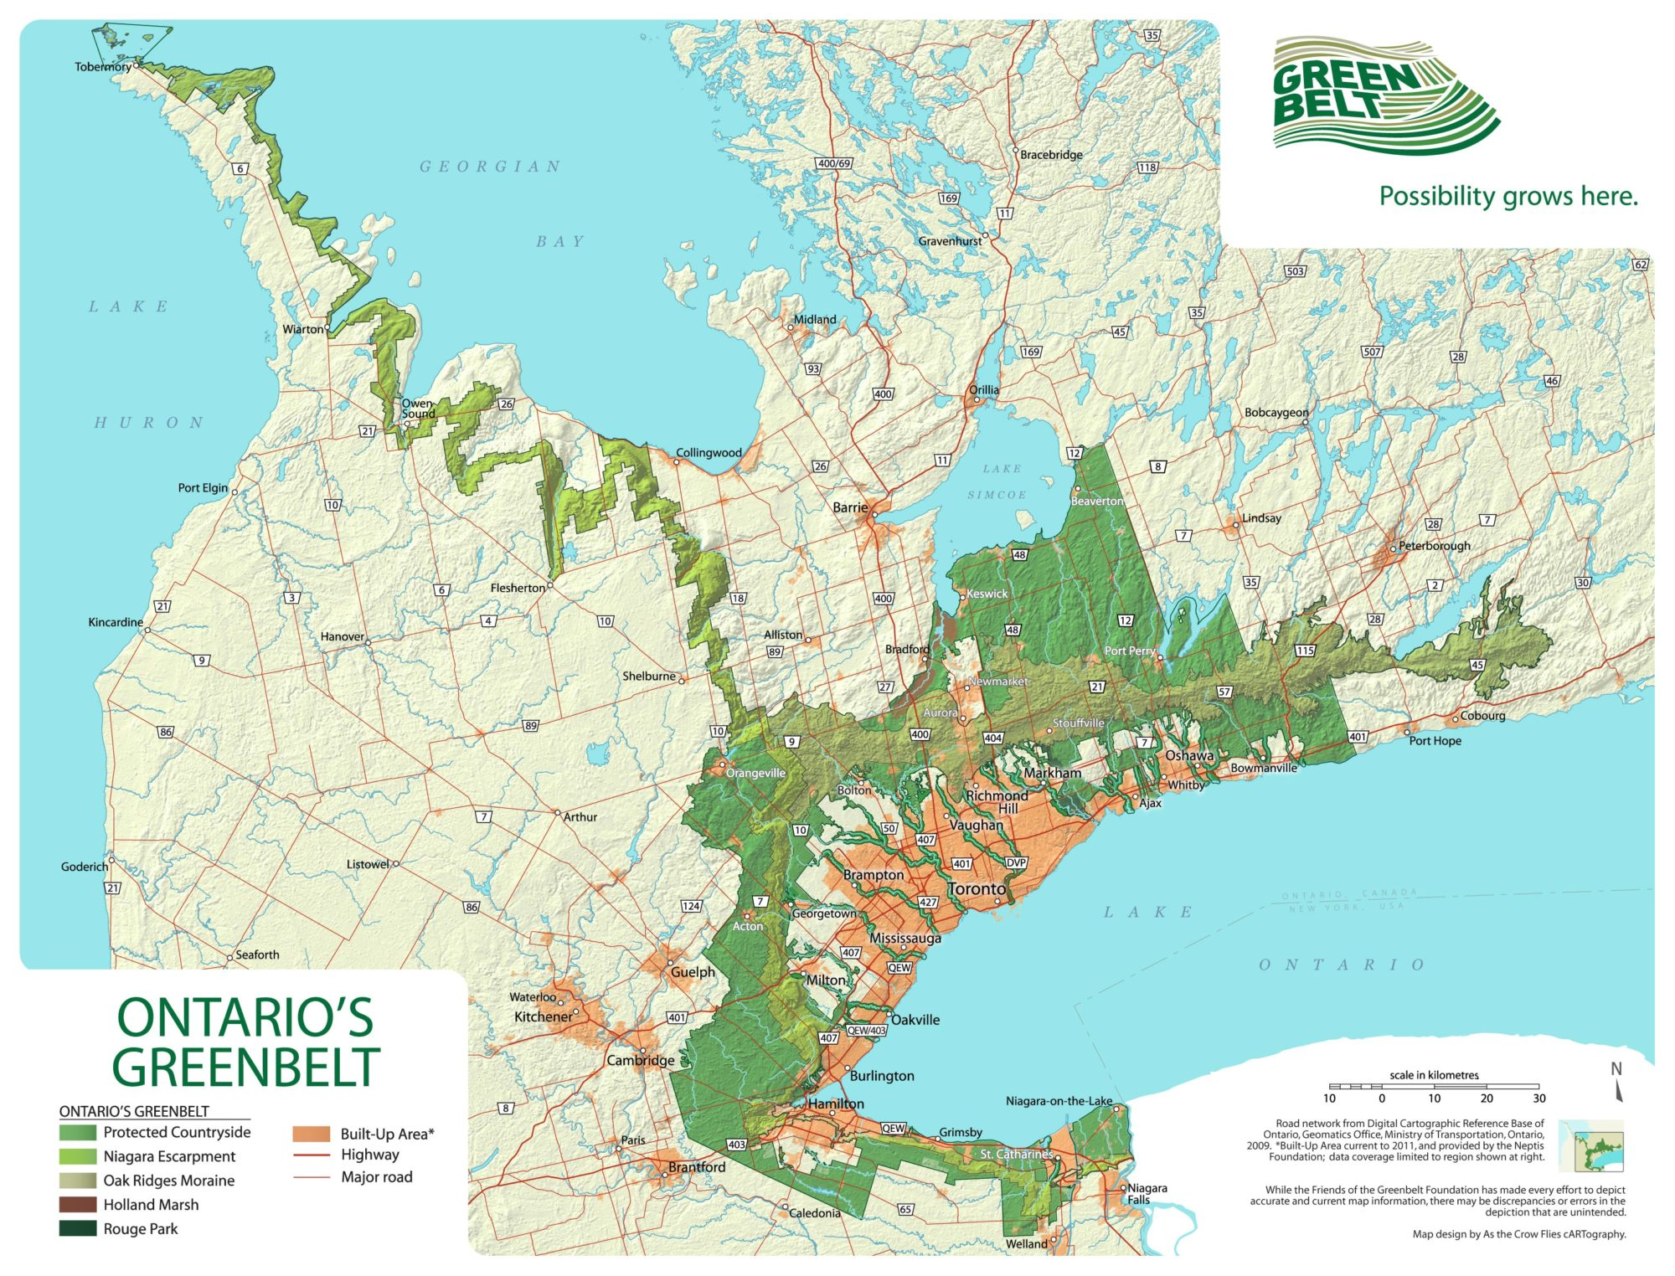
Problem and Background
ON Government wants to build 1.5 million new homes in 10 years
Requires new developable land due to the high costs of construction in city cores
Government wants to move greenbelt land further into the countryside
New land would free up space for residential development
Notes:
Musab & Artem:
A: Recently, the provincial government set a goal to build 1.5 million homes in the next 10 years.
Due to extremely high costs for construction and land acquisition in already developed areas, the PC’s are looking for other ways to fulfil this promise.
Which is why they proposed to cut into existing greenbelt land near the edges of the suburbs and add the same area of land further out in the countryside.
M: Although, this proved to be a controversial idea with many underlying issues. The government believes this will free up land that could be used for residential development.

Slide 5
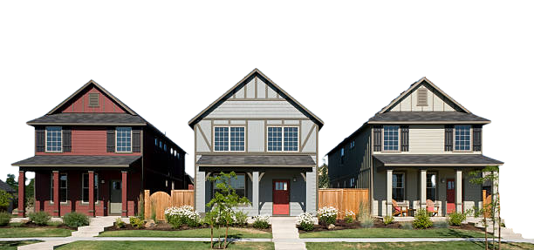
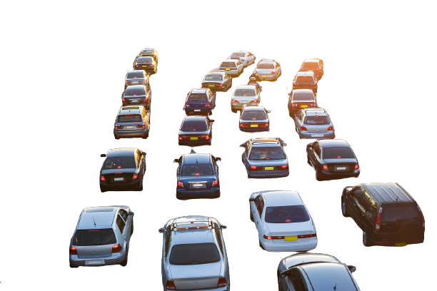
Problem Continued
Urban Problems
Solutions
Air and Noise Pollution
Traffic
Higher Crime Rates
Housing Shortage
Health Hazards
Unemployment Rate
Urban Expansion Outwards
Develop Housing in Suitable Areas
Build development near existing facilities
Notes:
Yousuf:
These are some of the problems leading to the proposal for development in the Greenbelt. Living in Peel Region we've felt a great deal of these problems, from heavy traffic to higher crime rates; from January of this year we've already surpassed the number of car thefts than in 2019, 2020, and 2021. So why do we have these problems? A big factor is urbanization, lots of people moving into the cities when we have a large population density with a shortage of housing! So what's the solution? Urban expansion outwards. Build housing near existing facilities.

Slide 6
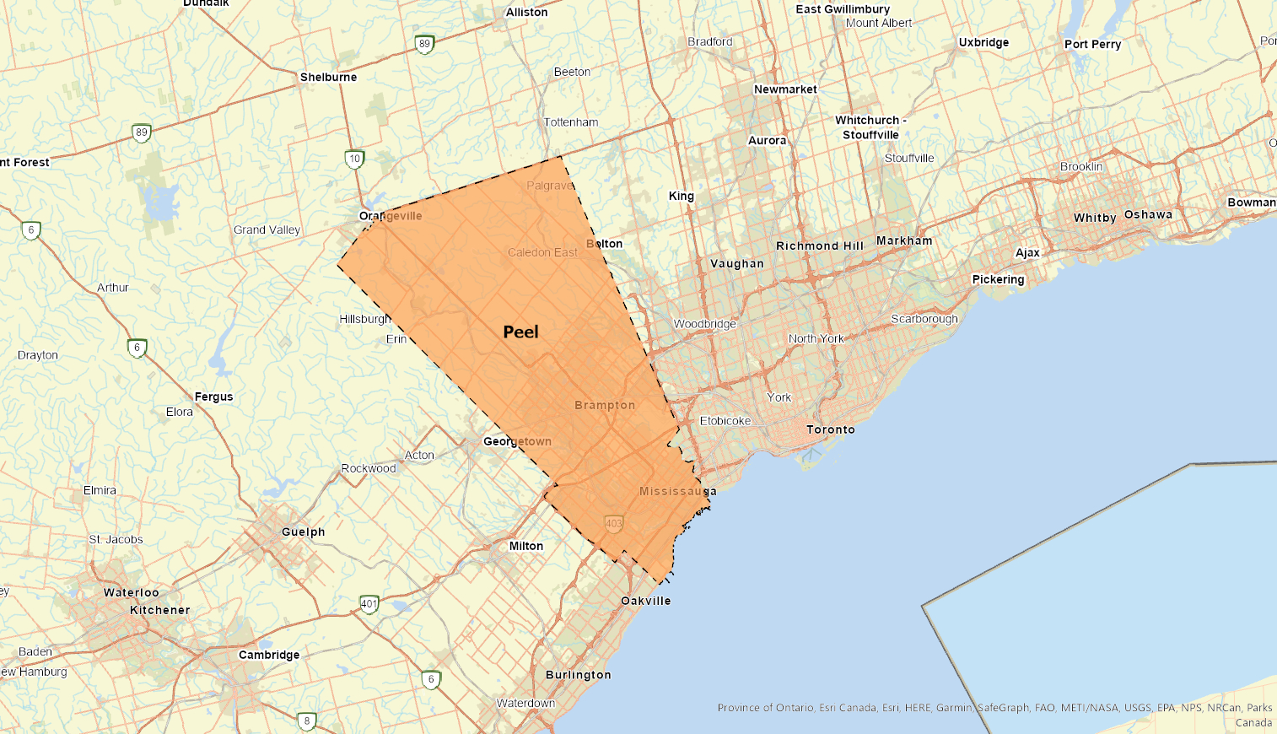
Goal
Analyze the greenbelt area contained within Peel
Determine suitable areas for development of housing using these considerations:
Slope of the area
Distance from Roads
Distance from facilities
Impassable land cover (Water Bodies)
Notes:
Musab: The goal of our project is to determine which parts of the greenbelt contained in Peel are suitable for residential development. Ideal areas would need to be under a 10 percent slope, be within an acceptable distance from roads and transportation, be within a kilometre of a facility, all while avoiding water bodies.

Slide 7

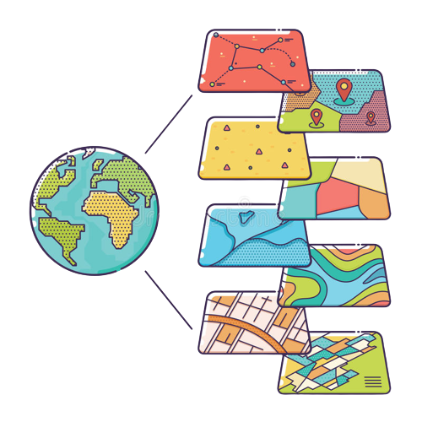
Data
Ontario Digital Elevation Model (DEM)
Ontario Greenbelt Boundary
Peel Region Boundary
Points file of Facilities (Peel Region)
Ontario Hydro Network - Waterbodies
Ontario Road Network
Notes:
Artem: The Data that we used to analyse the issue includes:
The elevation model for Southern Ontario
The greenbelt and peel region boundaries
The facilities and service buildings that Peel region has
The network of rivers and streams that flow into Peel
And the Road network for Southern Ontario

Slide 8

Geoprocessing Functions
Used
Erase
Extract by Mask
Slope
Con
Euclidean Distance
Raster Calculator
Notes:
Yousuf
So how did we do this?
Erase and Extract by Mask to manage the area of interest. Making sure it has no water bodies and has an elevation model for the Slope tool.
Next we used the Slope and Euclidean distance to meet our criterion for suitable housing
And finally Con and Raster Calculator to produce our result
These are the 6 functions utilized in our toolbox and script which we will now go more in depth in.

Slide 9
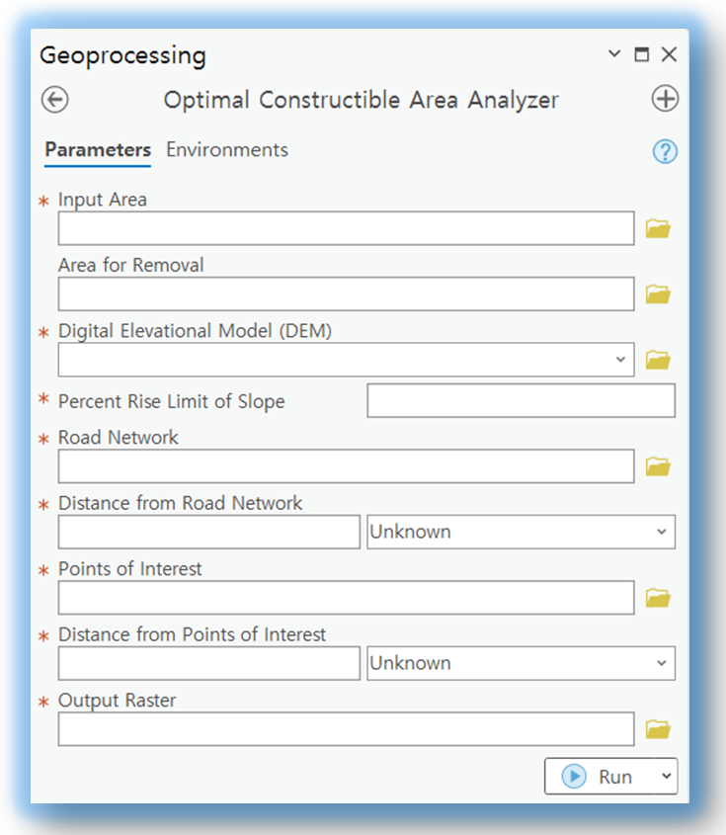

Tool Interface
Notes:
Young Jun: The script tool Optimal Constructible Area Analyzer takes in 5 mandatory and 1 optional user input data.
Young Jun: The tool first takes the Input Area which is the area or boundary of interest.
Young Jun: The optional parameter Area for Removal takes in any shapefile of area of complement that are to be removed within the Input Area.
Young Jun: If the user brings the refined shapefile for Input Area, then the Area for Removal section can be left as blank.
Young Jun: Now, it takes the DEM image file of the area and also takes in numerical input from the user for the limit of percent rise slope.
Young Jun: Road Network takes in a shapefile of the road network of the area of interest and allows the maximum distance for the proximity as a Linear Unit.
Young Jun: Points of Interest will be a collection of points and similar to the road network with adjustable maximum distance.
Young Jun: The name of the output raster can be modified and the default extension is tiff.

Slide 10
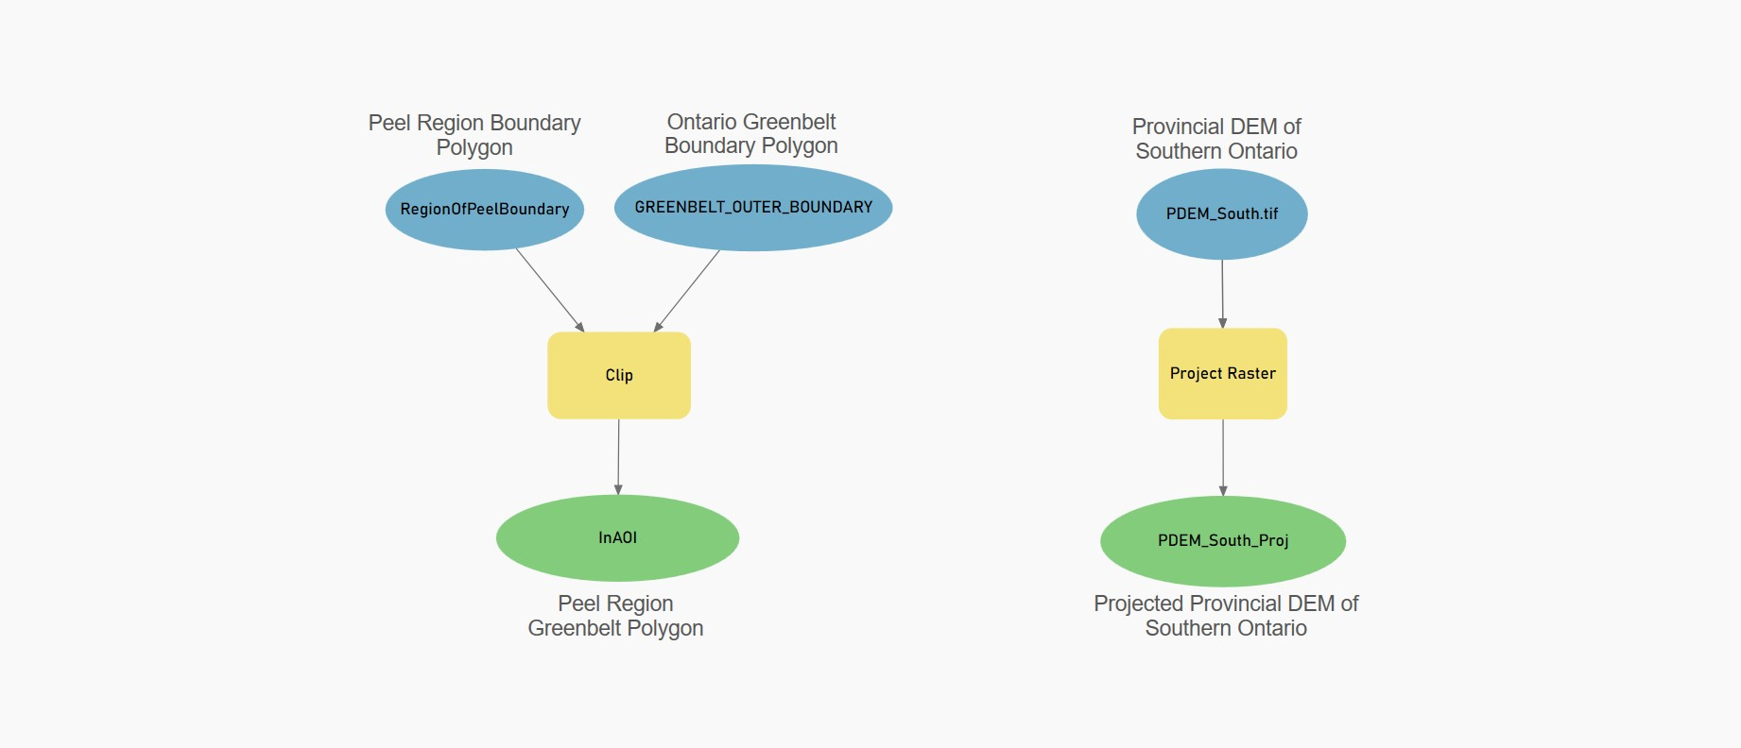
Model: Local Data Preparation
Notes:
Bhagat: Before we used our tool to perform suitability analysis on areas in the greenbelt, we had to do some preprocessing of the data. This included two things:
Getting the area of the green belt that lies in peel region to use as our area of interest.
Projecting the DEM of Ontario, to better align it with the projection of the other layers.

Slide 11
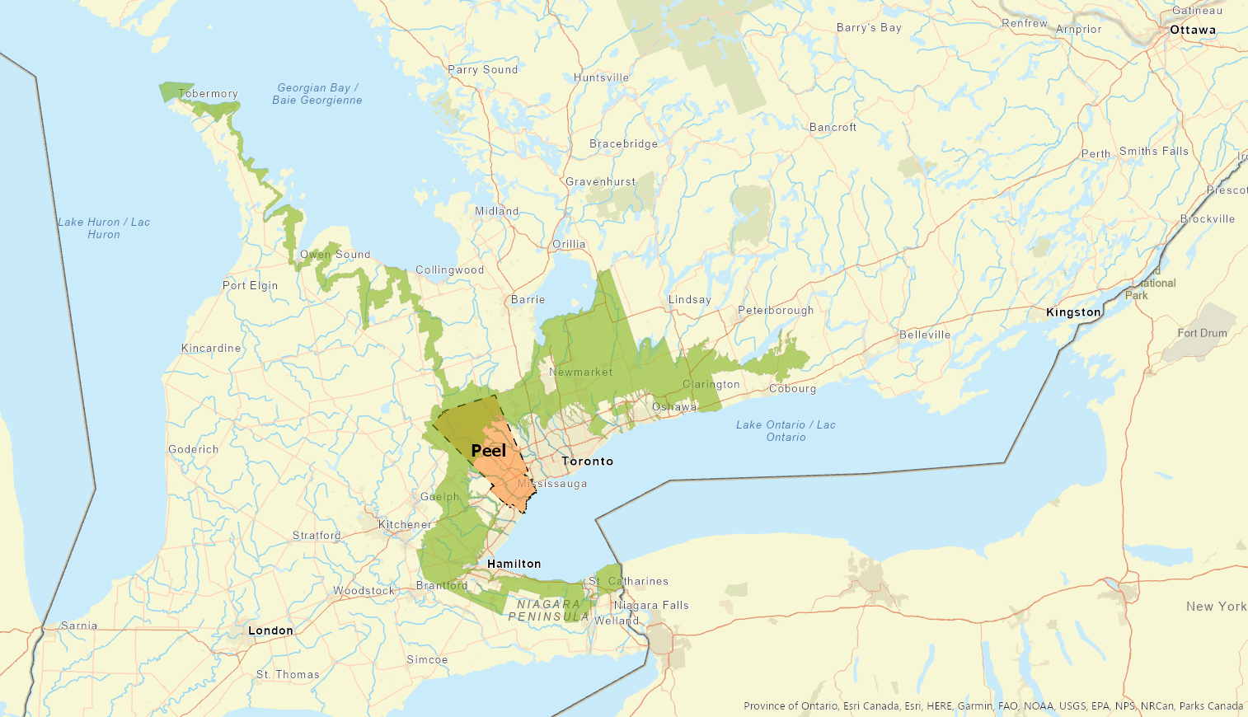
Notes:
Bhagat: In order to get the greenbelt area that lies in the peel region, we used the clip tool with the polygon layer of the peel region boundary as the clip feature (which is shown in orange here) and extracted the required area from the polygon layer of the greenbelt area (which is shown in green here)l.

Slide 12
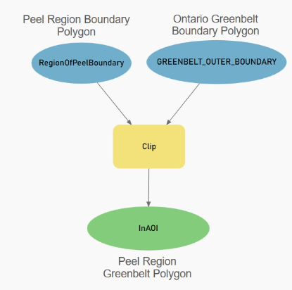
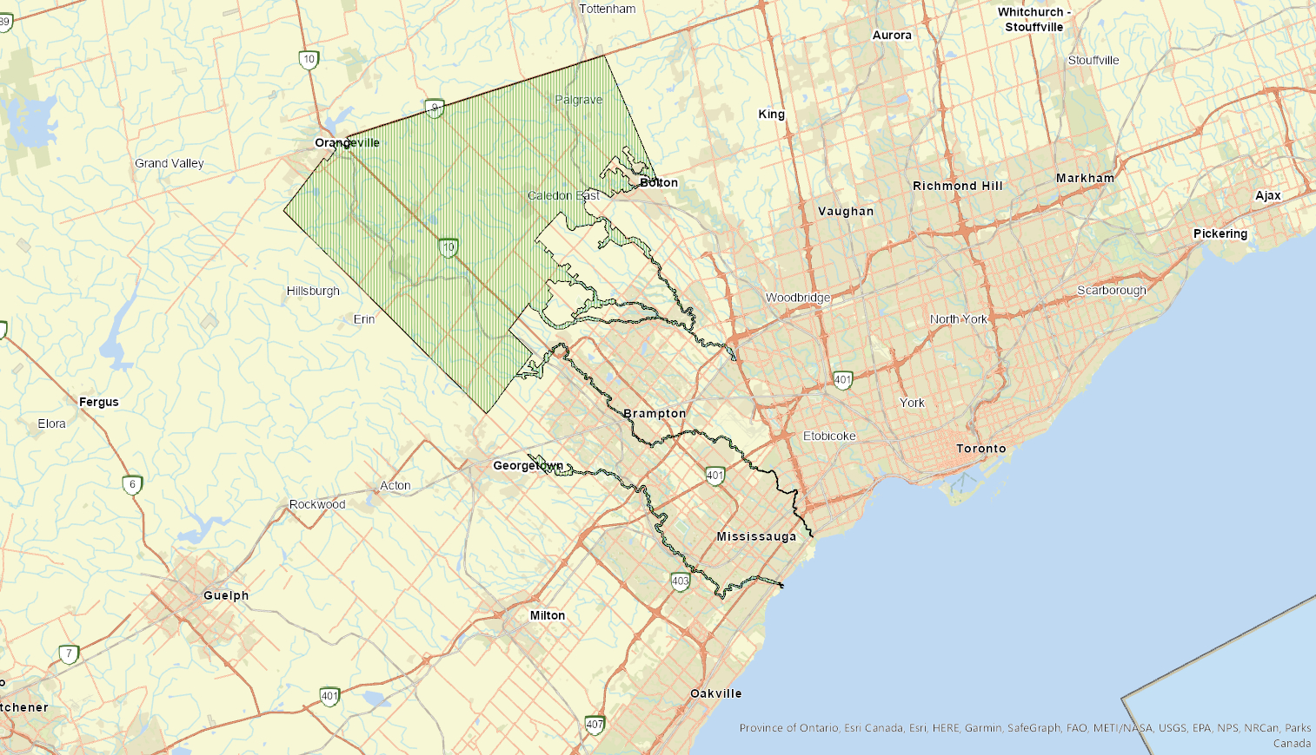
Notes:
Bhagat: This is what our result look likes after the clip. The area shown here is the greenbelt area that falls within the peel region.

Slide 13
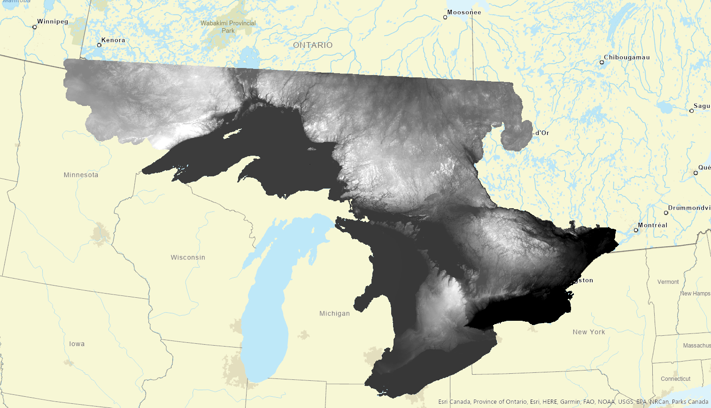
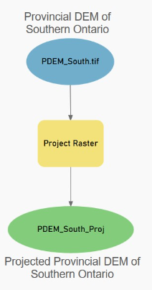
Notes:
Bhagat: We also did the projection of the Digital Elevation Model layer of Ontario and this is how the result look likes for the DEM after projecting.

Slide 14
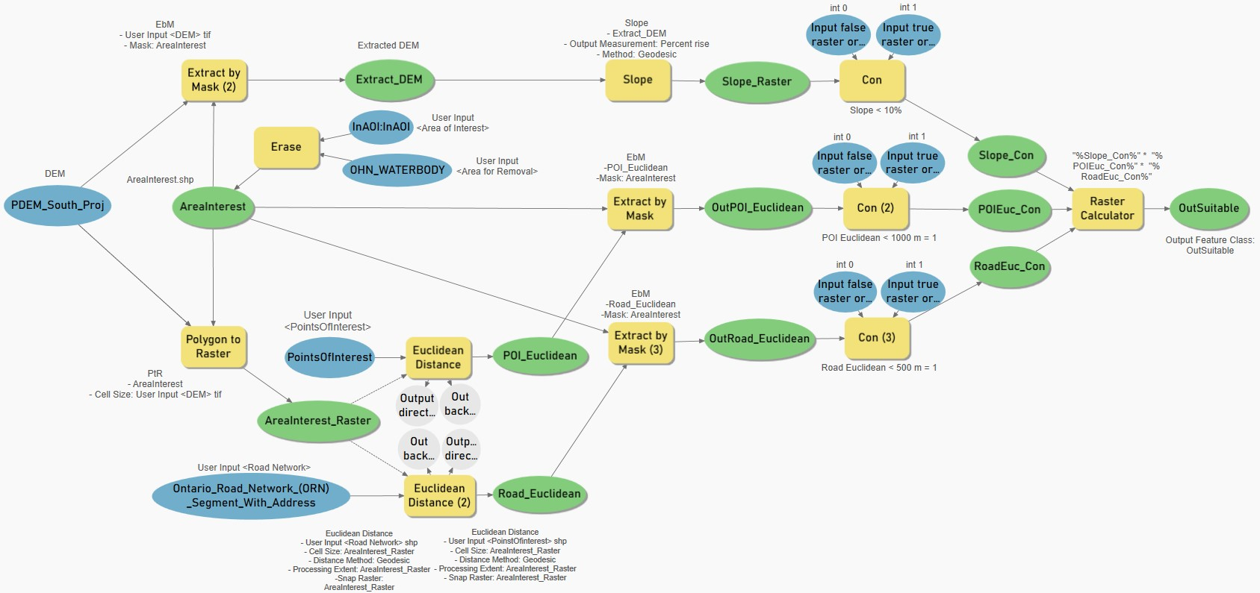
Model: Optimal Constructible Area
User Input
Files
Notes:
Young Jun: This is the model for general use that we used for both the project and script tool
Young Jun: just like the script tool, the model takes in 5 input feature classes which are circled in red.
Young Jun: Specifically for our project, DEM is already projected to the PCS that we decided to use and InAOI, the area of interest is clipped before the use of the model

Slide 15
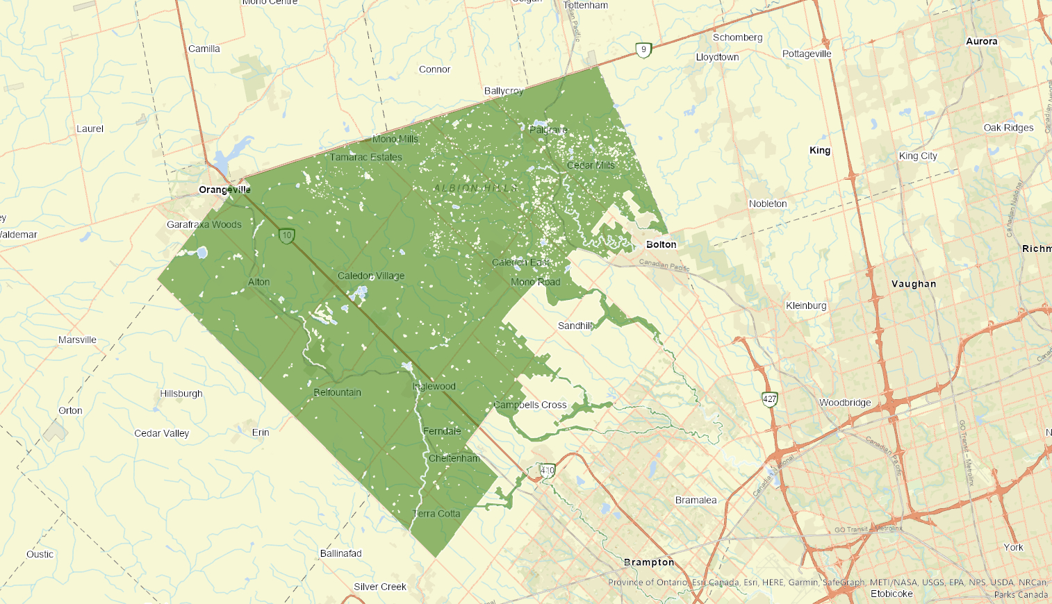
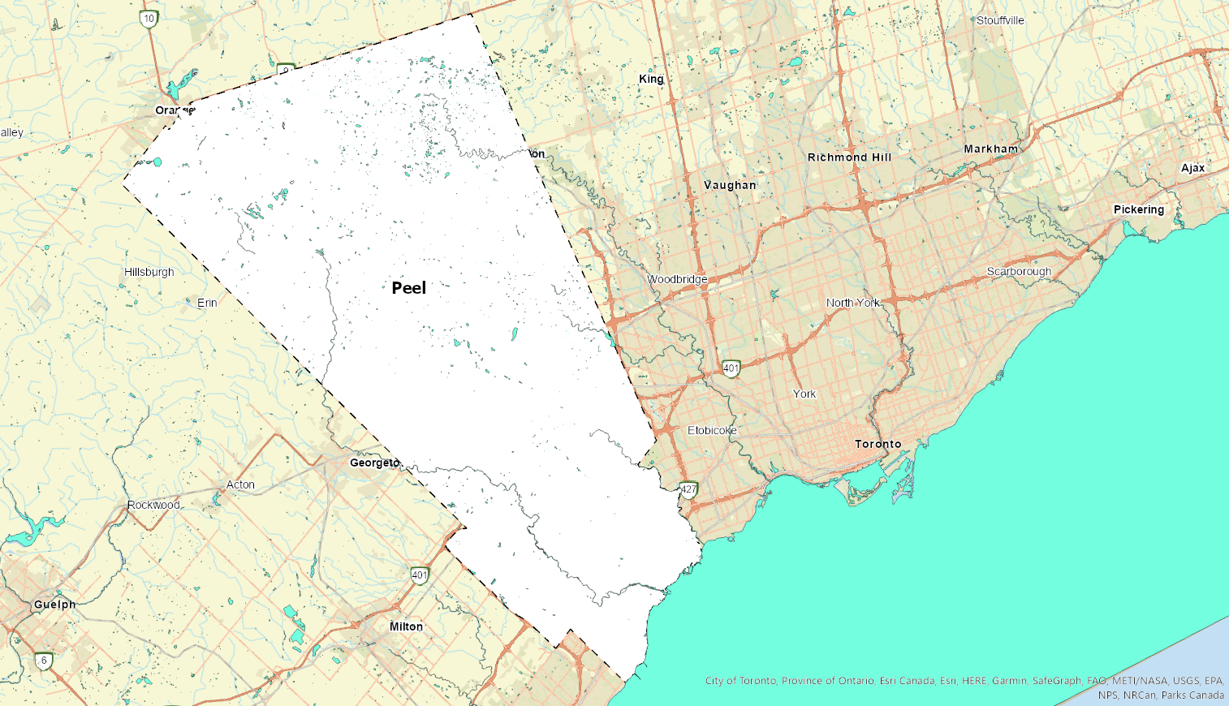
Erase
Notes:
Young Jun: the complement area will be the water bodies since we cannot build houses on top of water bodies,
so the Ontario Hydro Network Waterbody is taken as the Area of Removal input and using Erase function, the output contains the area of Peel region greenbelt with no water bodies.

Slide 16
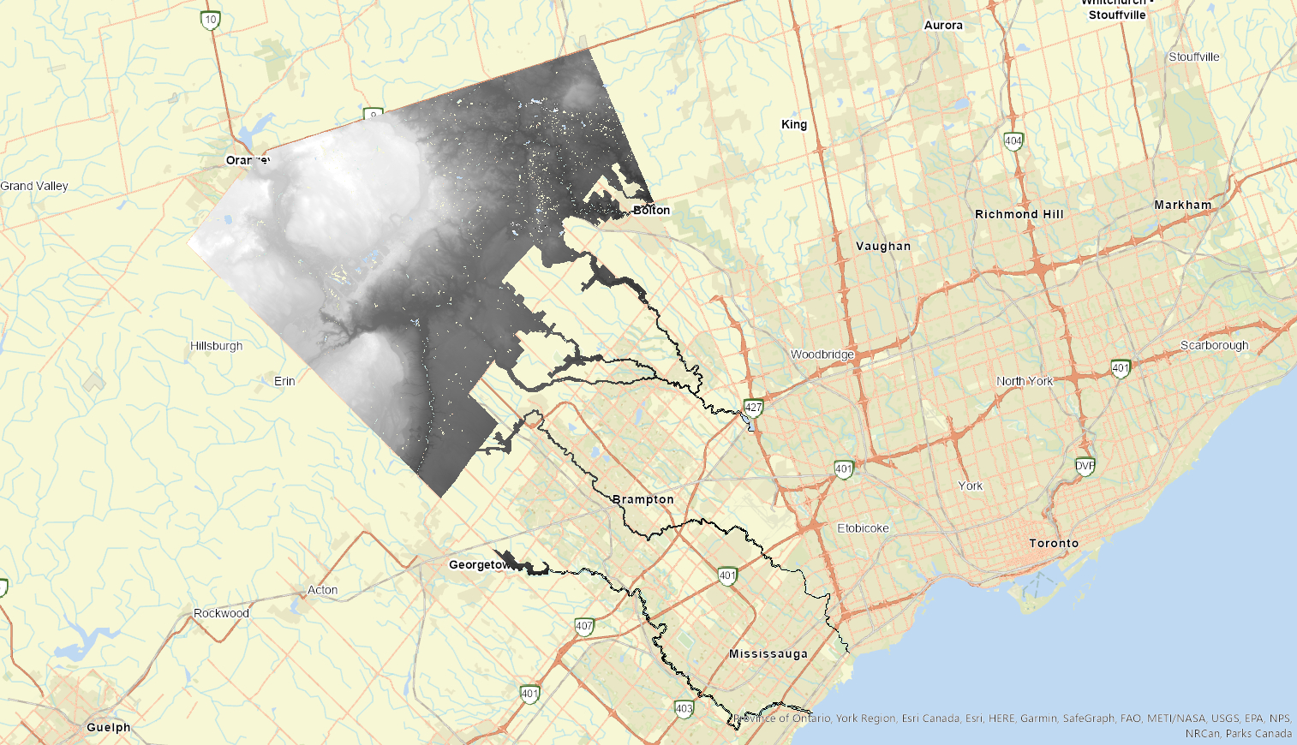
Extract by Mask
Notes:
Young Jun: Next, using Extract by Mask function, only DEM that are sitting within the output area of interest that we just acquired was extracted.

Slide 17
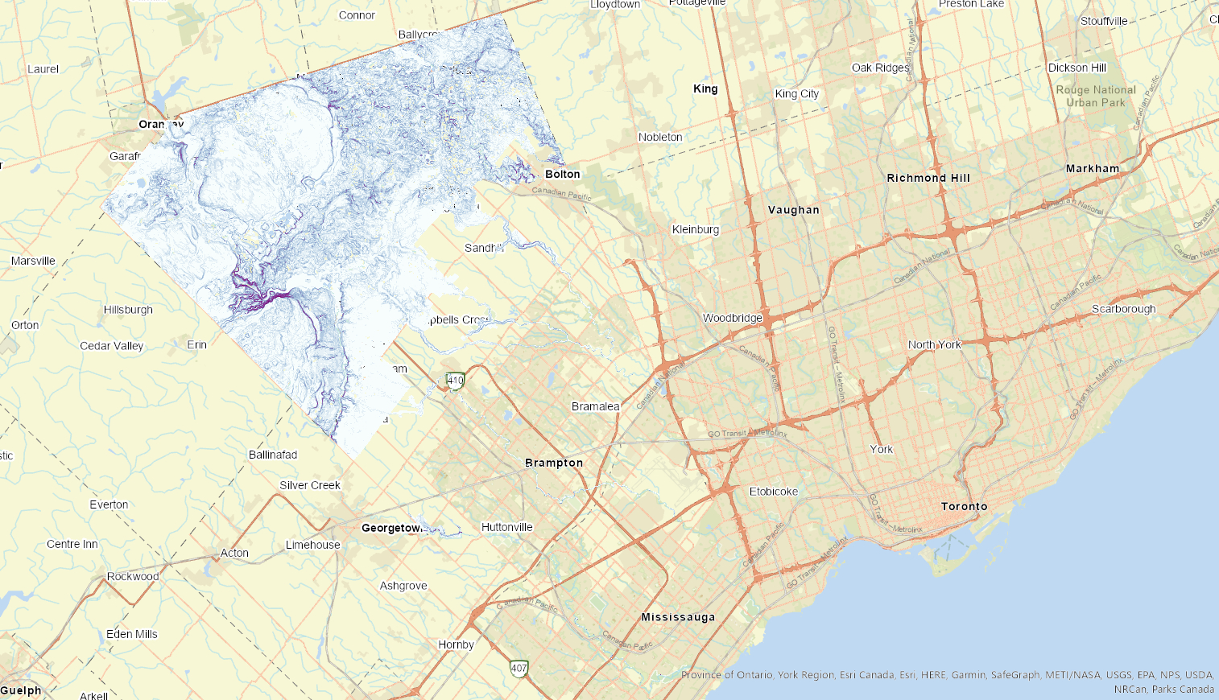
Slope Tool
Notes:
Young Jun: Now, on the extracted DEM layer, slope values in percent rise area calculated, using Slope function.

Slide 18
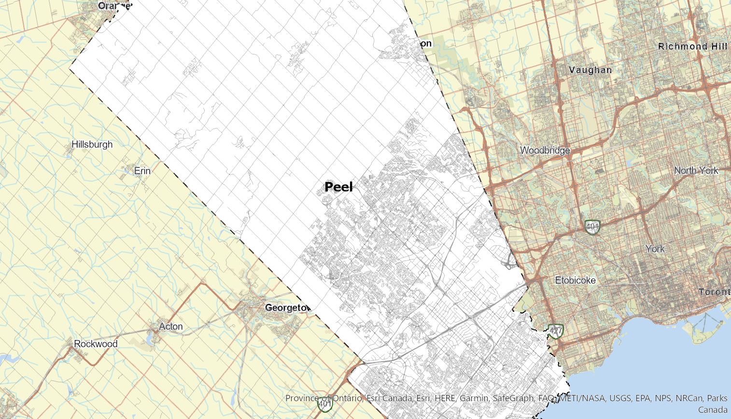
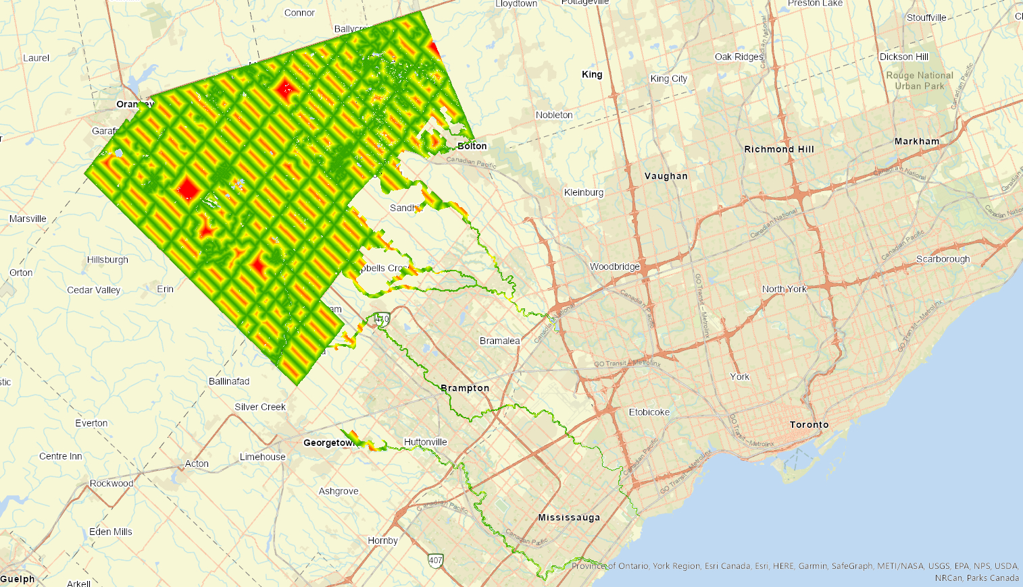
Euclidean Distance
Notes:
Young Jun: Taking the new area of interest as boundary, we created an Euclidean Distance raster layer based on the Ontario Road Network vector layer
Young Jun: and in this case, the maximum distance for the proximity was set to 500 metres.

Slide 19
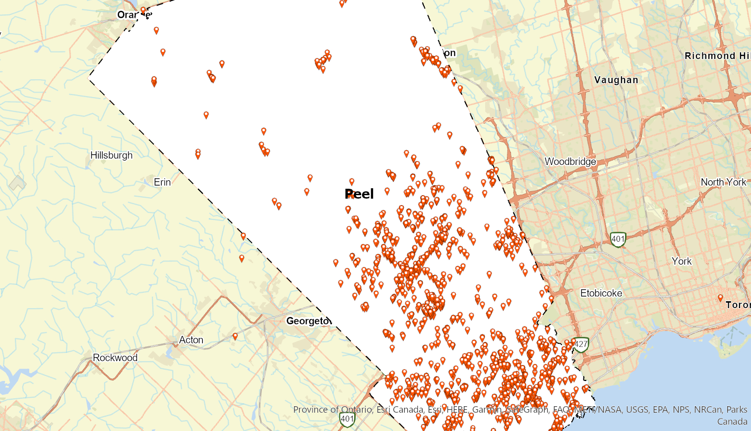
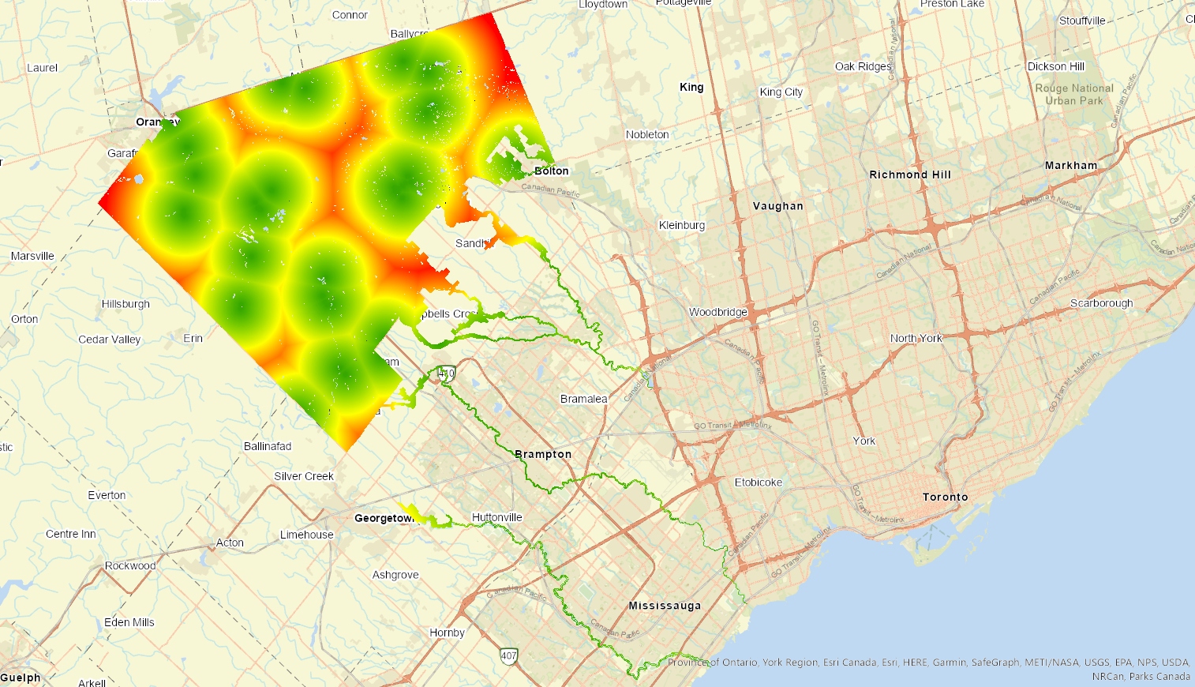
Euclidean Distance
Notes:
Young Jun: Similar to last slide we created an Euclidean Distance raster layer based on the all the facilities in Peel Region
Young Jun: and the maximum distance for the proximity was set to 1 kilometres.

Slide 20
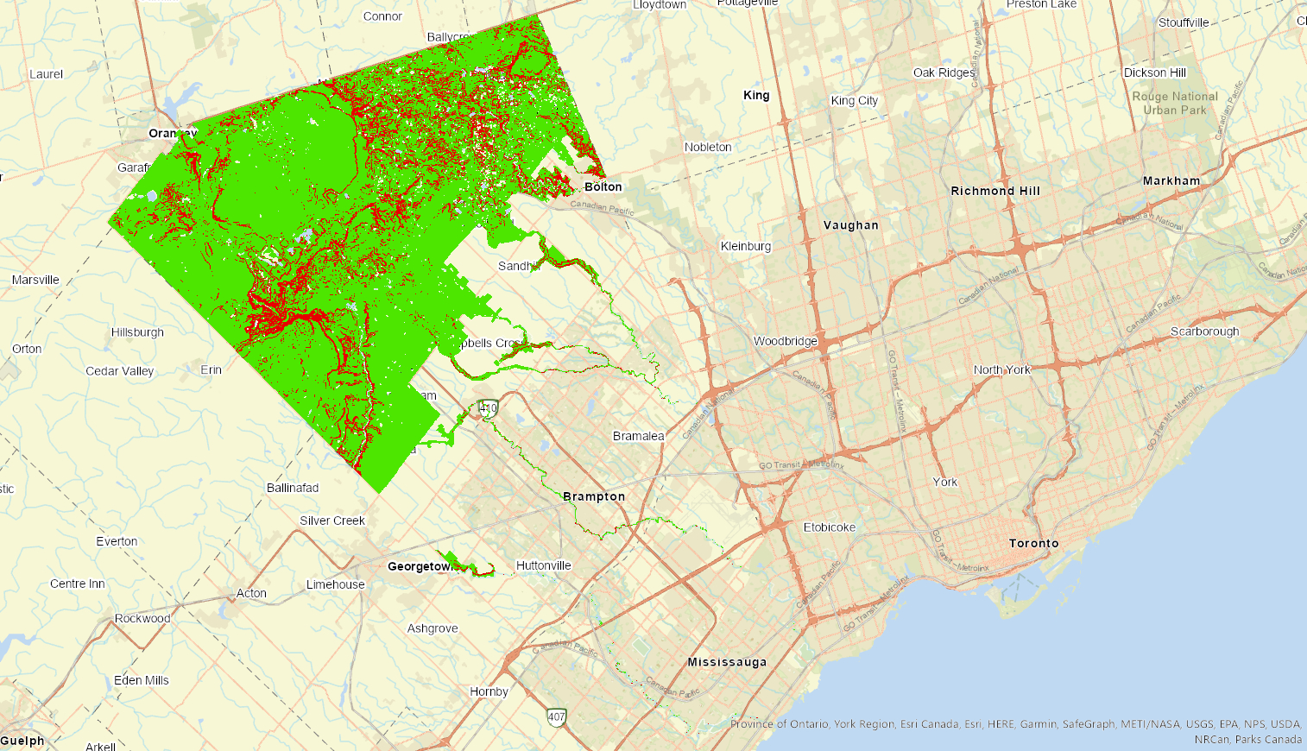
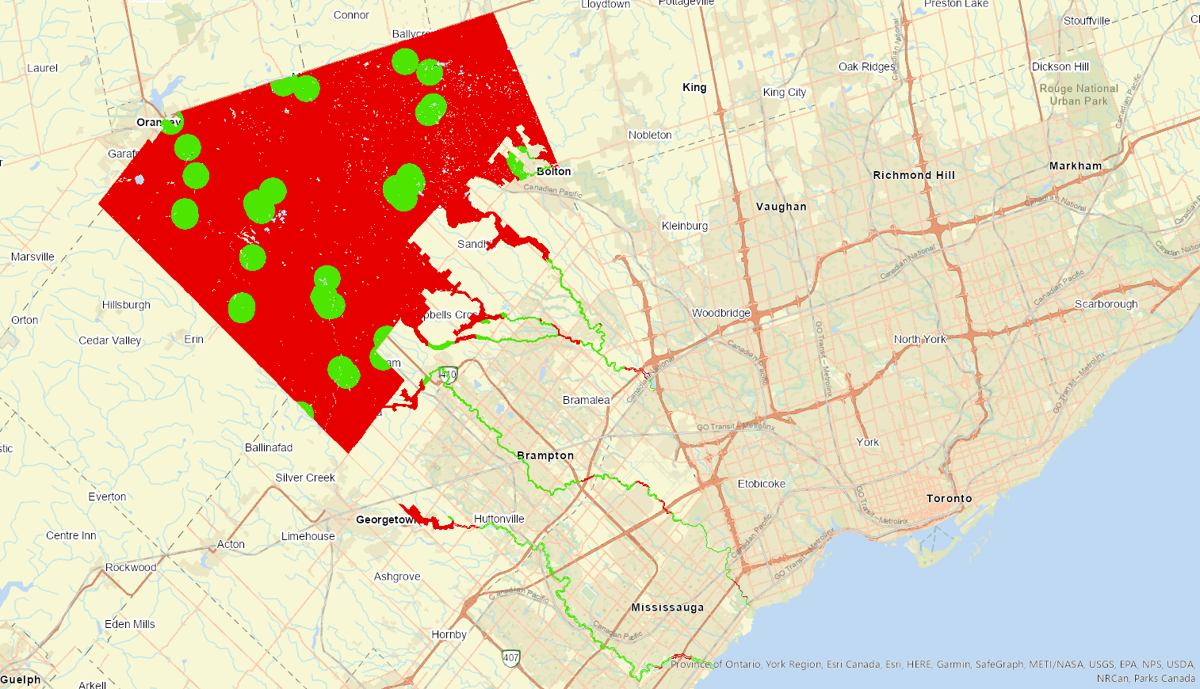
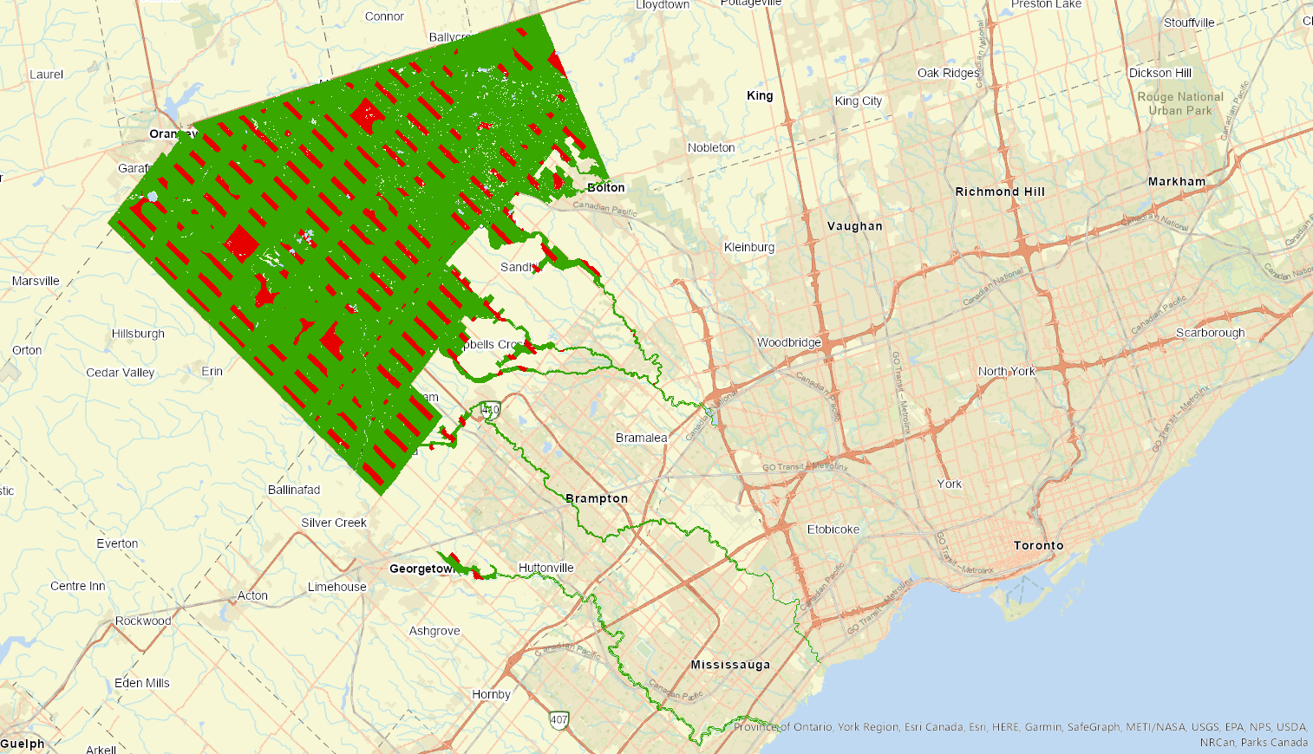
Con Tool
for Slope Layer
for POI Euclidean Distance Layer
for Roads Euclidean Distance Layer
Notes:
Young Jun: Using Con Tool, for each of raster layer for slope, Points-of-Interest Euclidean Distance, and Road Network Euclidean Distance,
Which are assigned a value of 1 for valid cells and 0 for invalid cells.
Young Jun: The slope layer is set to valid only if the cell area has less than or equal to 15 percent rise.
The Points-of-Interest Euclidean Distance raster is valid if the distance is less than or equal to 1 kilometer, and similar for the Road Network Euclidean raster, but with 500 metres condition.

Slide 21
Raster Calculator
Notes:
Young Jun: After each process of Con function, they are converted into raster layer with cells of 0 invalid and 1 valid.
Young Jun: And now, to extract the only areas where satisfies all three criteria: slope allowance and acceptable proximity to road network and facilities, the idea of AND logical operator is used, which is to process the multiplication of all three raster layers using Raster Calculator function.

Slide 22
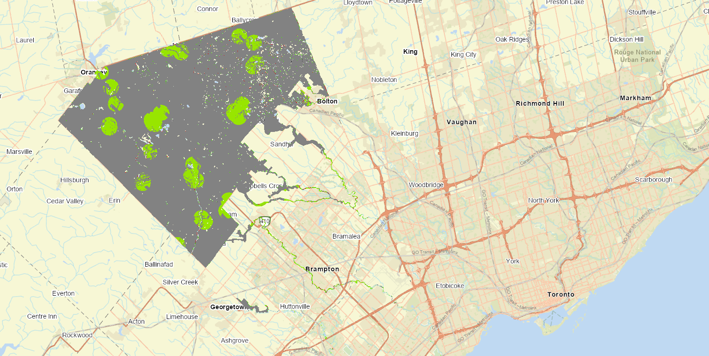
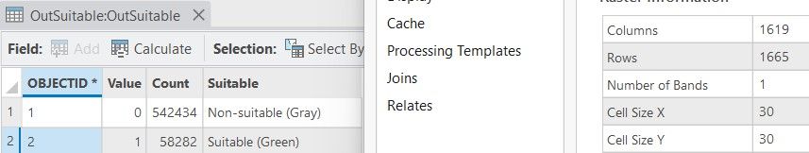
Results
Area Not Optimal for Construction
542,434 cells × 30²㎡ ⁄ (1,000²㎡) = 488.1906 ㎢
Area Optimal for Construction
58,282 cells× 30²㎡ ⁄ (1,000²㎡) = 52.4538 ㎢
Notes:
Sunny: The final suitability raster highlights candidate areas in light green, and we have computed the total suitable land to be about 52 square kilometres or around 11% of the total area of interest.
Sunny: While most of the areas are isolated patches, there are two small chains of suitable areas, one extending from Orangeville, and the other from Ballycroy. Orangeville is perhaps a familiar name, but Ballycroy is different.
Sunny: With a population of just 200, and most businesses abandoned, it’s considered by many to be a ghost town, yet we did not read about resurrection in the job description.

Slide 23
Limitations & Future Considerations
Limitations:
Could not use land cover because of land reclassification which is unique for each user. Making it hard to have a specific type of reclassification for all land cover inputs.
Water bodies shapefile was not completely accurate
Unable to obtain reliable information on suitable land acquisition costs
For Future Considerations:
Have different weights for the distances from different buildings
Use walking distance as a factor in areas that have a limited road network
Split the plots of suitable land by zoning by building type (single-family, townhouses, apartments)
Notes:
Sunny: With our analysis completed, we gave some reflection for the road ahead (no pun intended).
Sunny: We thought about limiting factors that we hope to overcome in a future redesign, such as not being able to use land cover data since land cover classification varies across geographies and also upon user interpretation. We also noted that our water bodies dataset was not entirely dependable as it was missing smaller bodies of water such as streams and tributaries. We could also not obtain any data for evaluating the cost to buy and develop on land.
Sunny: Other future considerations are having the ability to weigh the distances from different buildings based on their category (ie. should development be closer to businesses or social services?). We would like to consider walking distance for regions will limited road networks. And we would also like to consider ways to zone the suitable development space to prioritize building types (single-family units, townhouses, apartments, etc.)

Slide 24
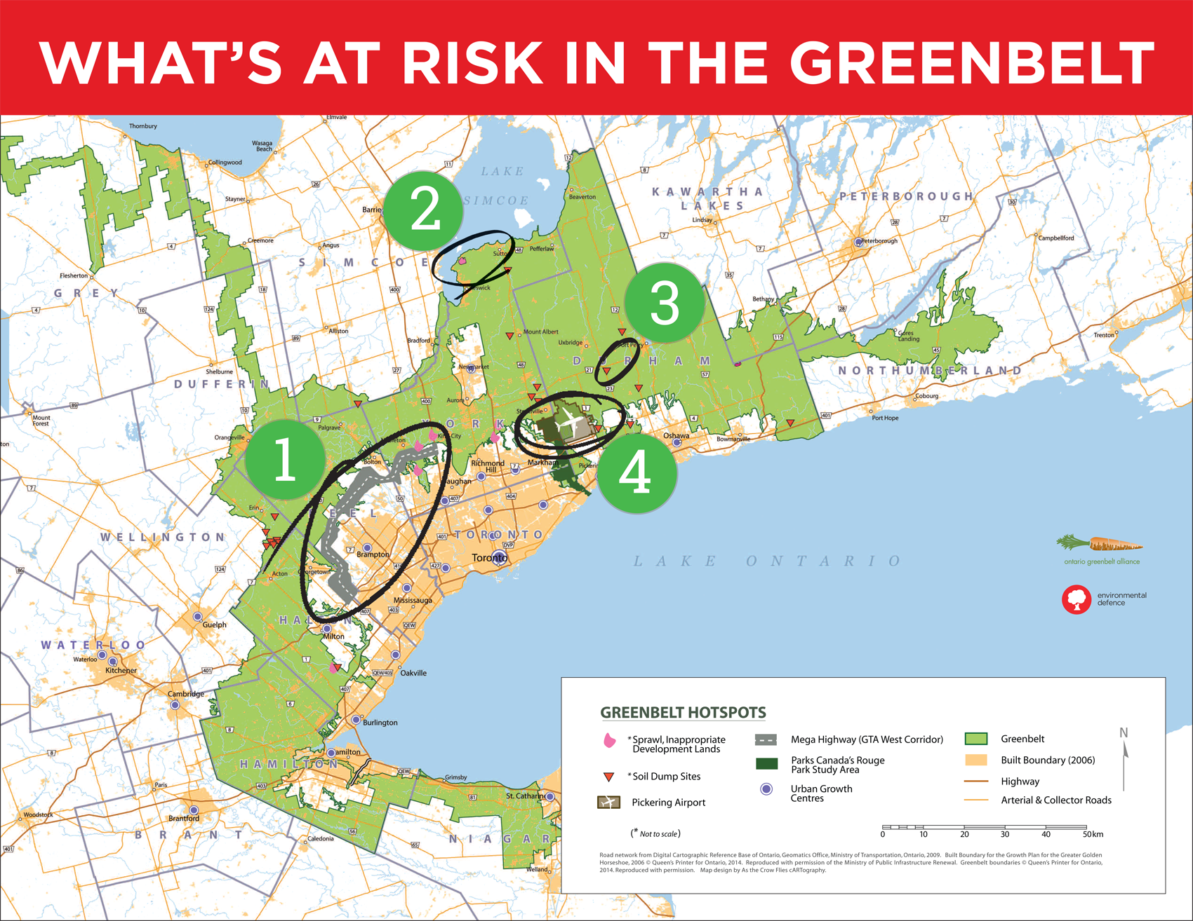
Future Projects
Notes:
Sunny: All these considerations are important as the government has many development projects outside of homes in mind. These include the GTA West corridor also known as Highway 413, and the Pickering airport.

Slide 25
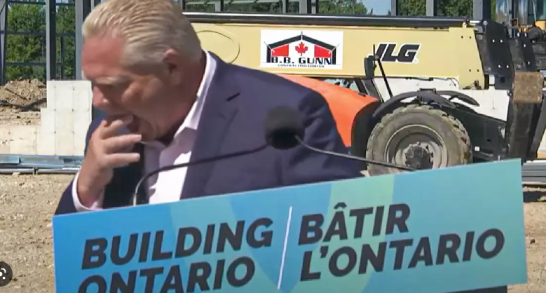



Member Contributions
Special Credits:
Doug Ford, Ontario PC Party (10%)
Bee (90%)
Background Research & Designing Process
Artem Oleinikov Sunny Parmar
Model Building & Script Coding
Young Jun Jeong Bhagatinder Longia
Presentation Preparation
Musab Muhammad Yousuf Mirza
Notes:
Yousef:
BIG thank you to Doug Ford for hiring our GIS team for this project. This is our original layout of contributions so every member has a part, but of course the work load was mixed with questions being asked and answered and help being given where needed.

Slide 26
References
McIntosh, E. (2022, December 3). Everything you need to know about Doug Ford's plan to cut into Ontario's Greenbelt. The Narwhal. Retrieved December 3, 2022, from https://thenarwhal.ca/ontario-greenbelt-plan-ford-housing/#:~:text=The%20Ford%20government%20is%20proposing,of%20Greenbelt%20land%20for%20development.&text=The%20Ontario%20government%20announced%20plans,promises%20to%20leave%20it%20intact
M., Moe, Says, B., Buildingadvisor, Says, J., Jani, says, L., Laney, says, N., Nick, says, C. D., Dalfonso, C., says, K. D., Dunbar, K., says, M., Matts, says, N., Naresh, says, L. E., … Foster, L. (2022, May 5). Evaluating a building lot -- slope, soils, drainage, radon, and more. Building Advisor. Retrieved December 3, 2022, from https://buildingadvisor.com/buying-land/site-characteristics/slope-soils-water-vegetation/
Ontario's greenbelt under threat. Environmental Defence. (2022, November 25). Retrieved December 3, 2022, from https://environmentaldefence.ca/report/ontarios-greenbelt-under-threat-a-study-on-whats-at-risk/
What are the Greenbelt's shortcomings? Neptis Foundation. (2021, November 2). Retrieved December 3, 2022, from https://neptis.org/publications/chapters/what-are-greenbelts-shortcomings
Notes:
Yousef:
References for our project and further reading on the issues at stake. Again we do not condone Doug Ford’s plan to expand into the Greenbelt.

Slide 27
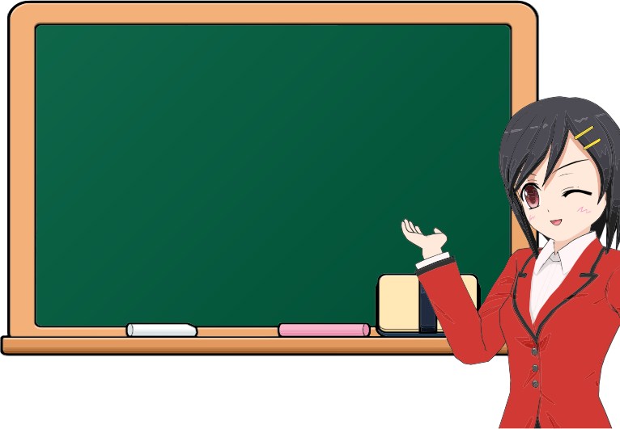
End of Presentation
Thank you
Notes:
Yousef:
Thank you for listening. Any questions?

Slide 28
Things to add [delete at end]
Problem (0.5 min): Identify the problem you wish to solve and the scope of your project
Background (0.5 min): Background of the problem
Solution (0.5 min): Description of how your group solved the problem with GIS programming
Data Processing and Programming (2 min): A flowchart illustrating your data processing and programming
Results (1 min): Analysis of your work and results
Member Contributions (0.5 min): Description of each team member’s contribution

Slide 32


